Slide 1

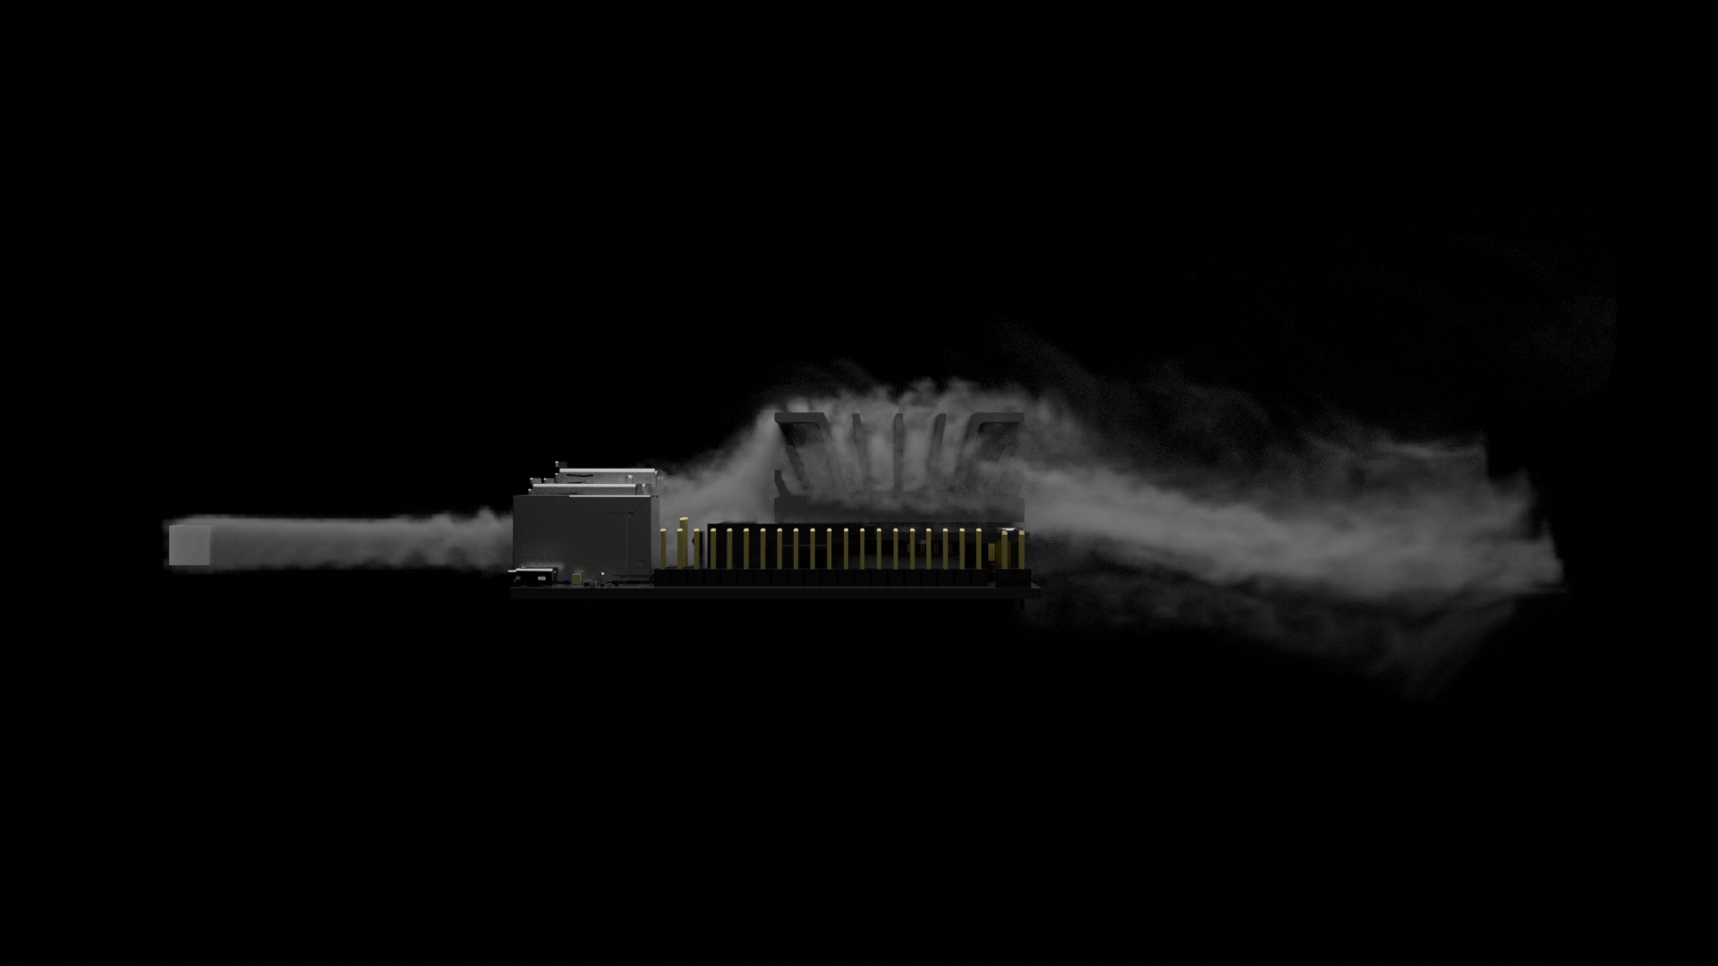
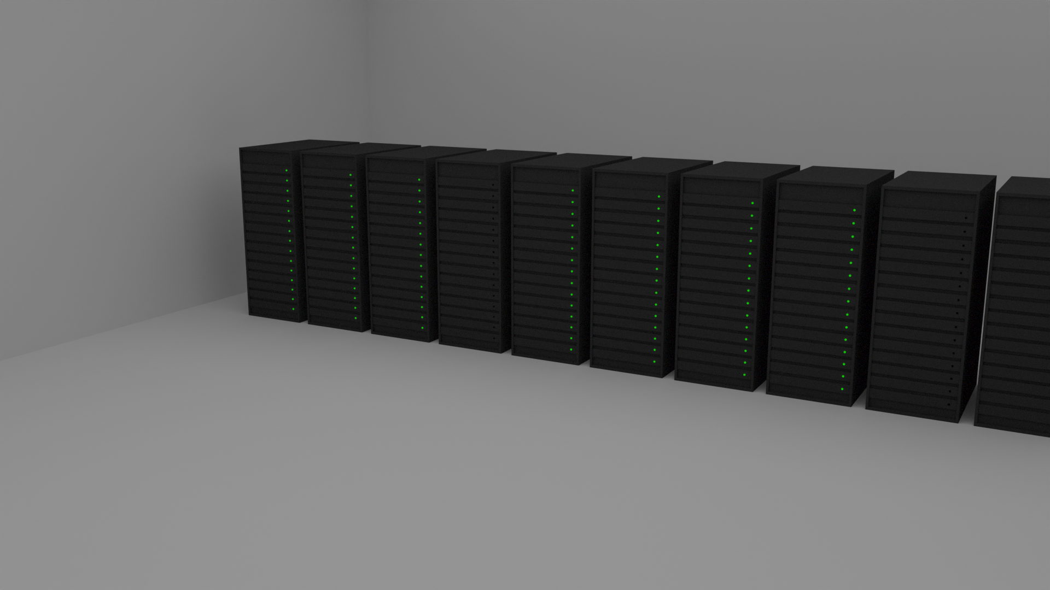
GOING VIRAL:

Slide 2
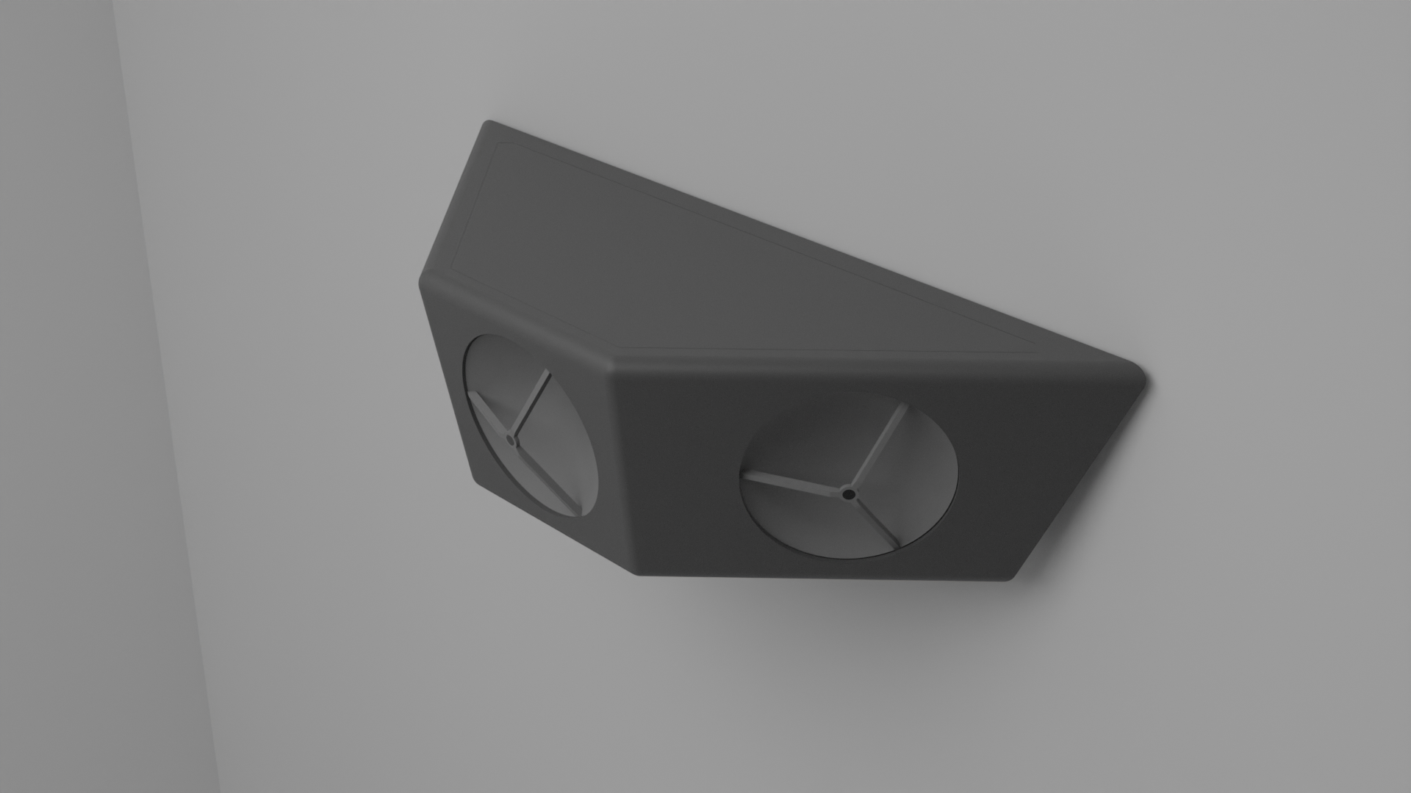
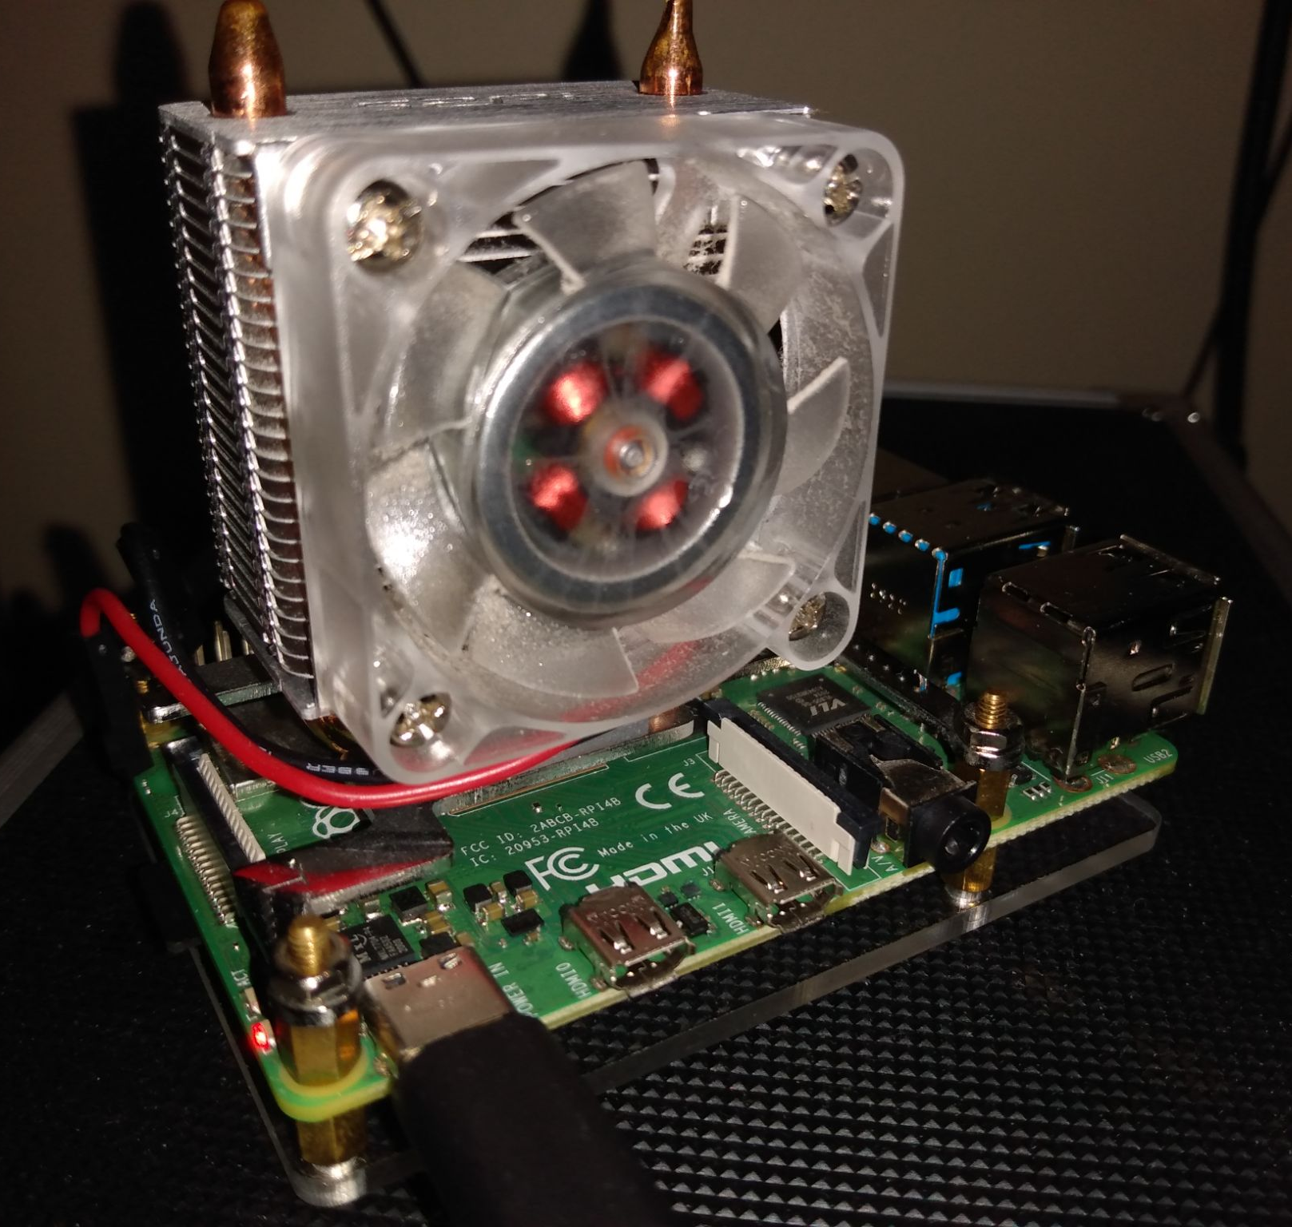
OUR INNOVATION
What it is, how it is planned to operate, how it was made
1

Slide 3
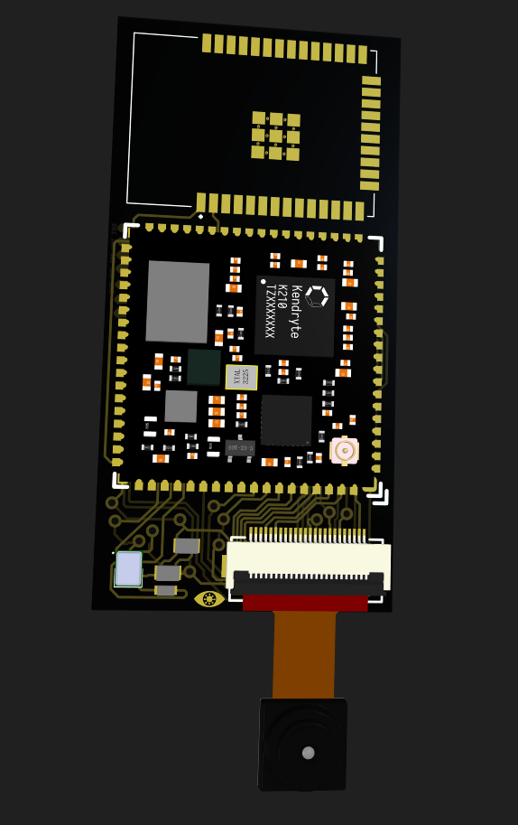
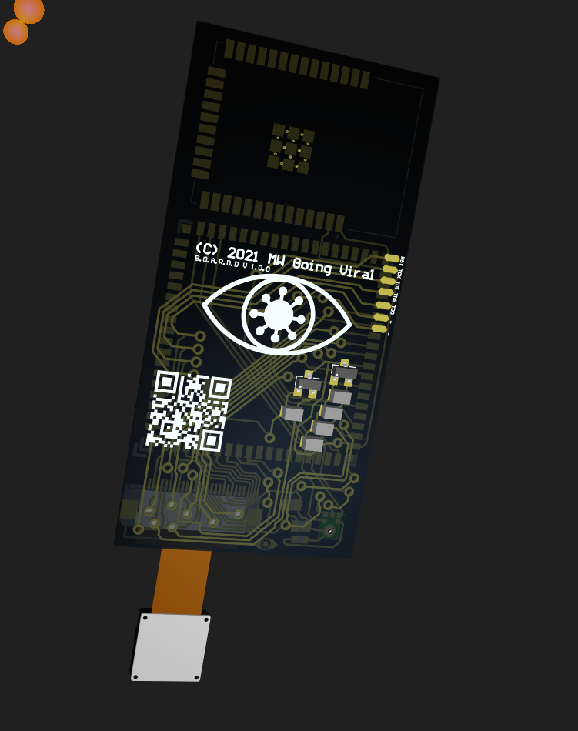
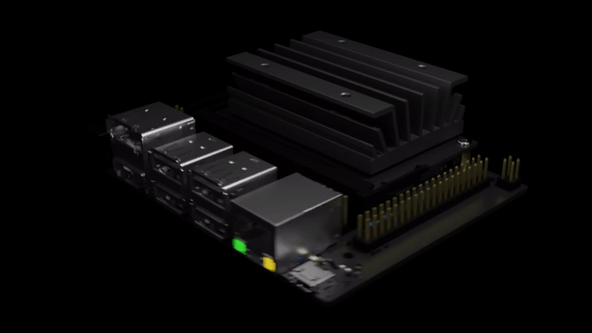
Biometrically
BOARDD
Observant
Automatic
Respiratory
Disease
Detection
A device meant to monitor the spread of infectious diseases throughout communities
Prototype based off ESP32 and Sipeed M1.

Slide 4
BOARDD Server and Website
The BOARDD Server is:
Where all the BOARD data ends up
Process the data into powerful visual displays
How it works:
Receives coordinates and case number from boards
Compiles the data into a “raw” geojson file
Uses the raw file to generate the other data visualizations

Slide 5
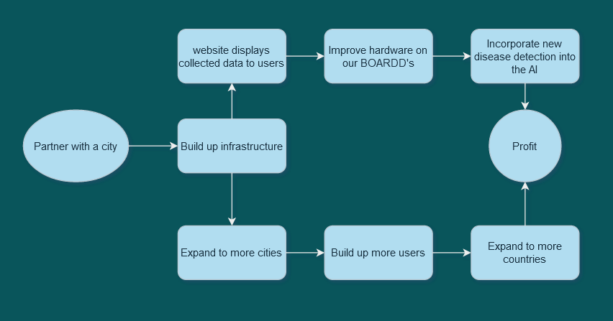
Operation Plan

Slide 6

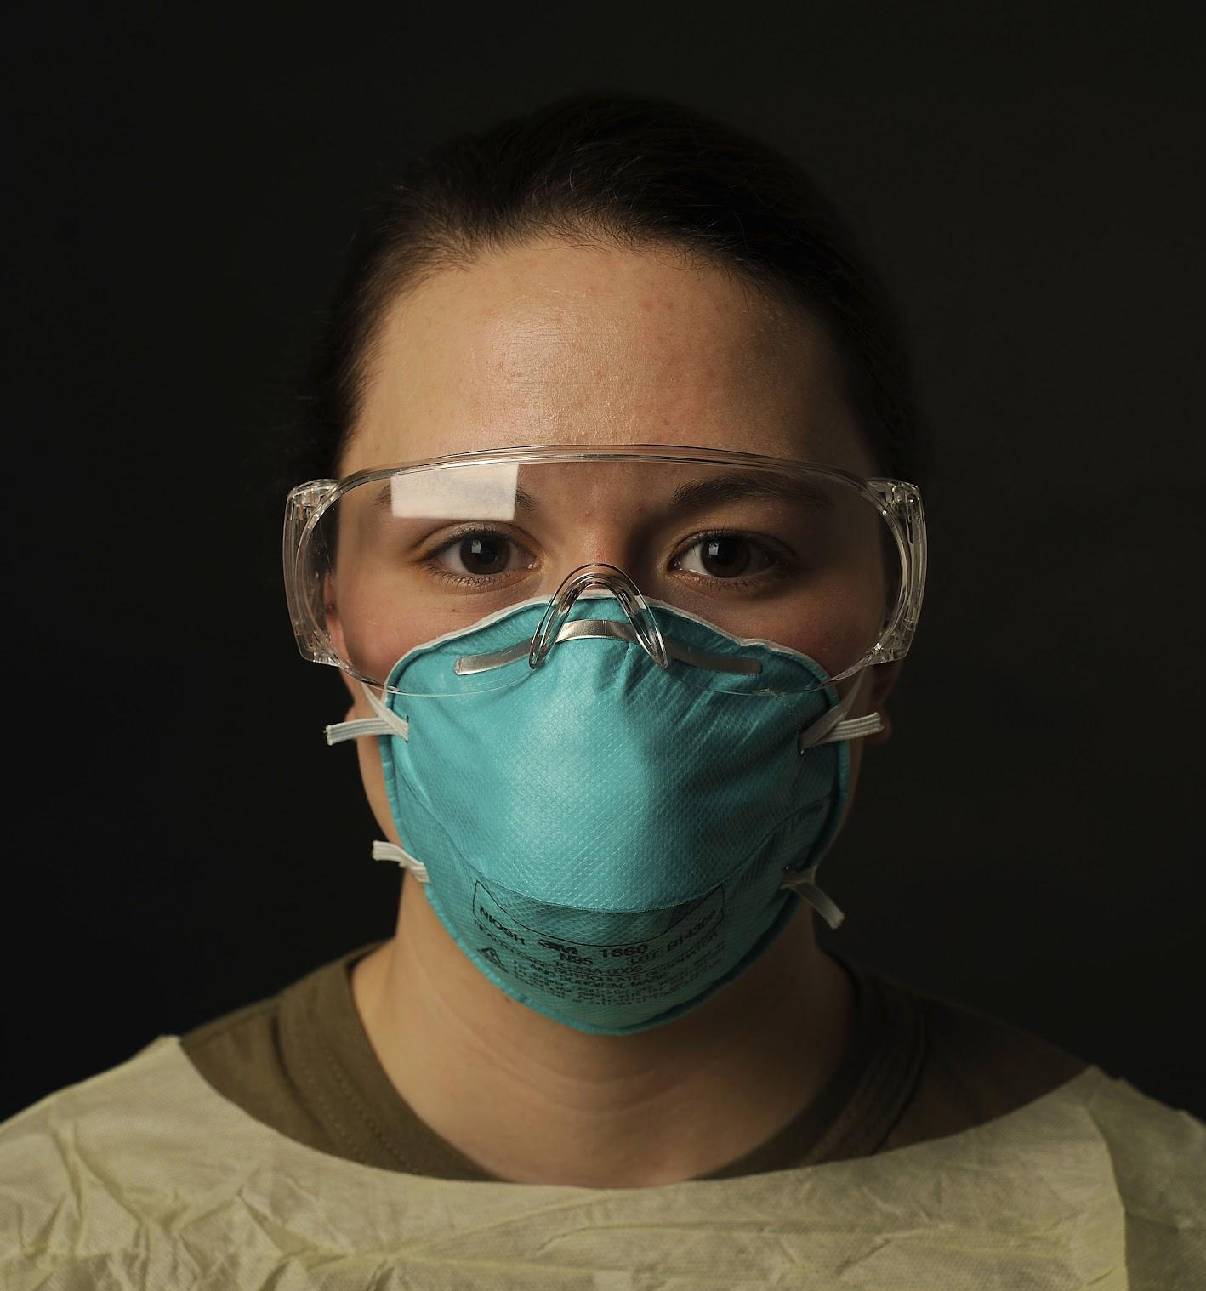
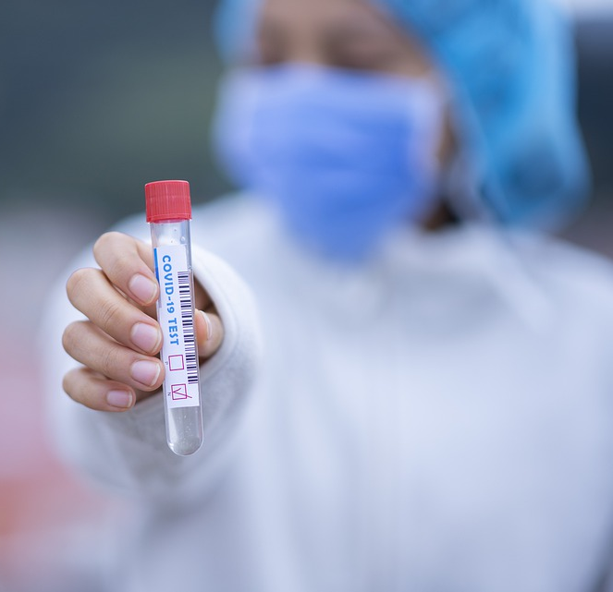
PURPOSE
What problem it solves, how it solves it, what makes it unique
2

Slide 7
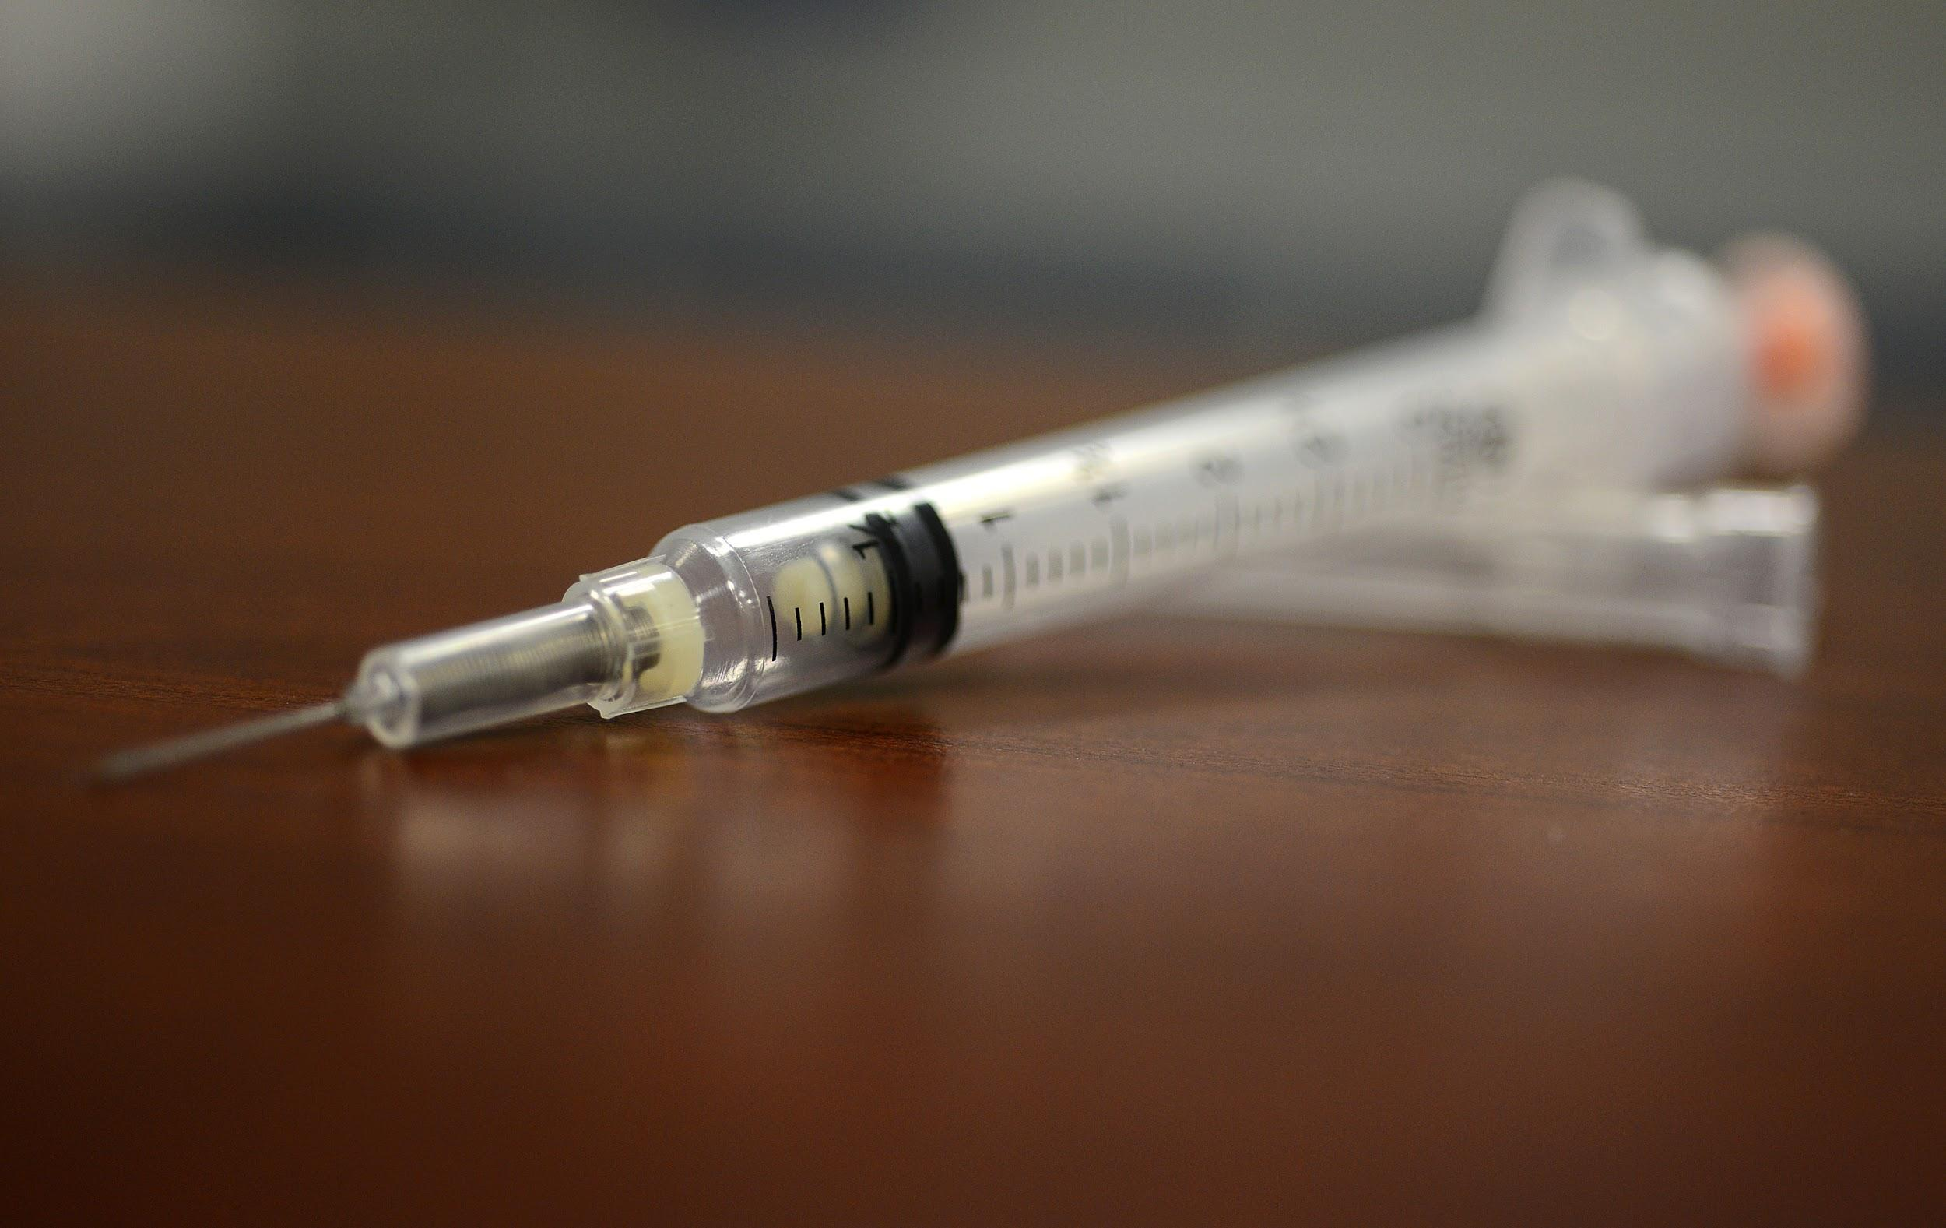
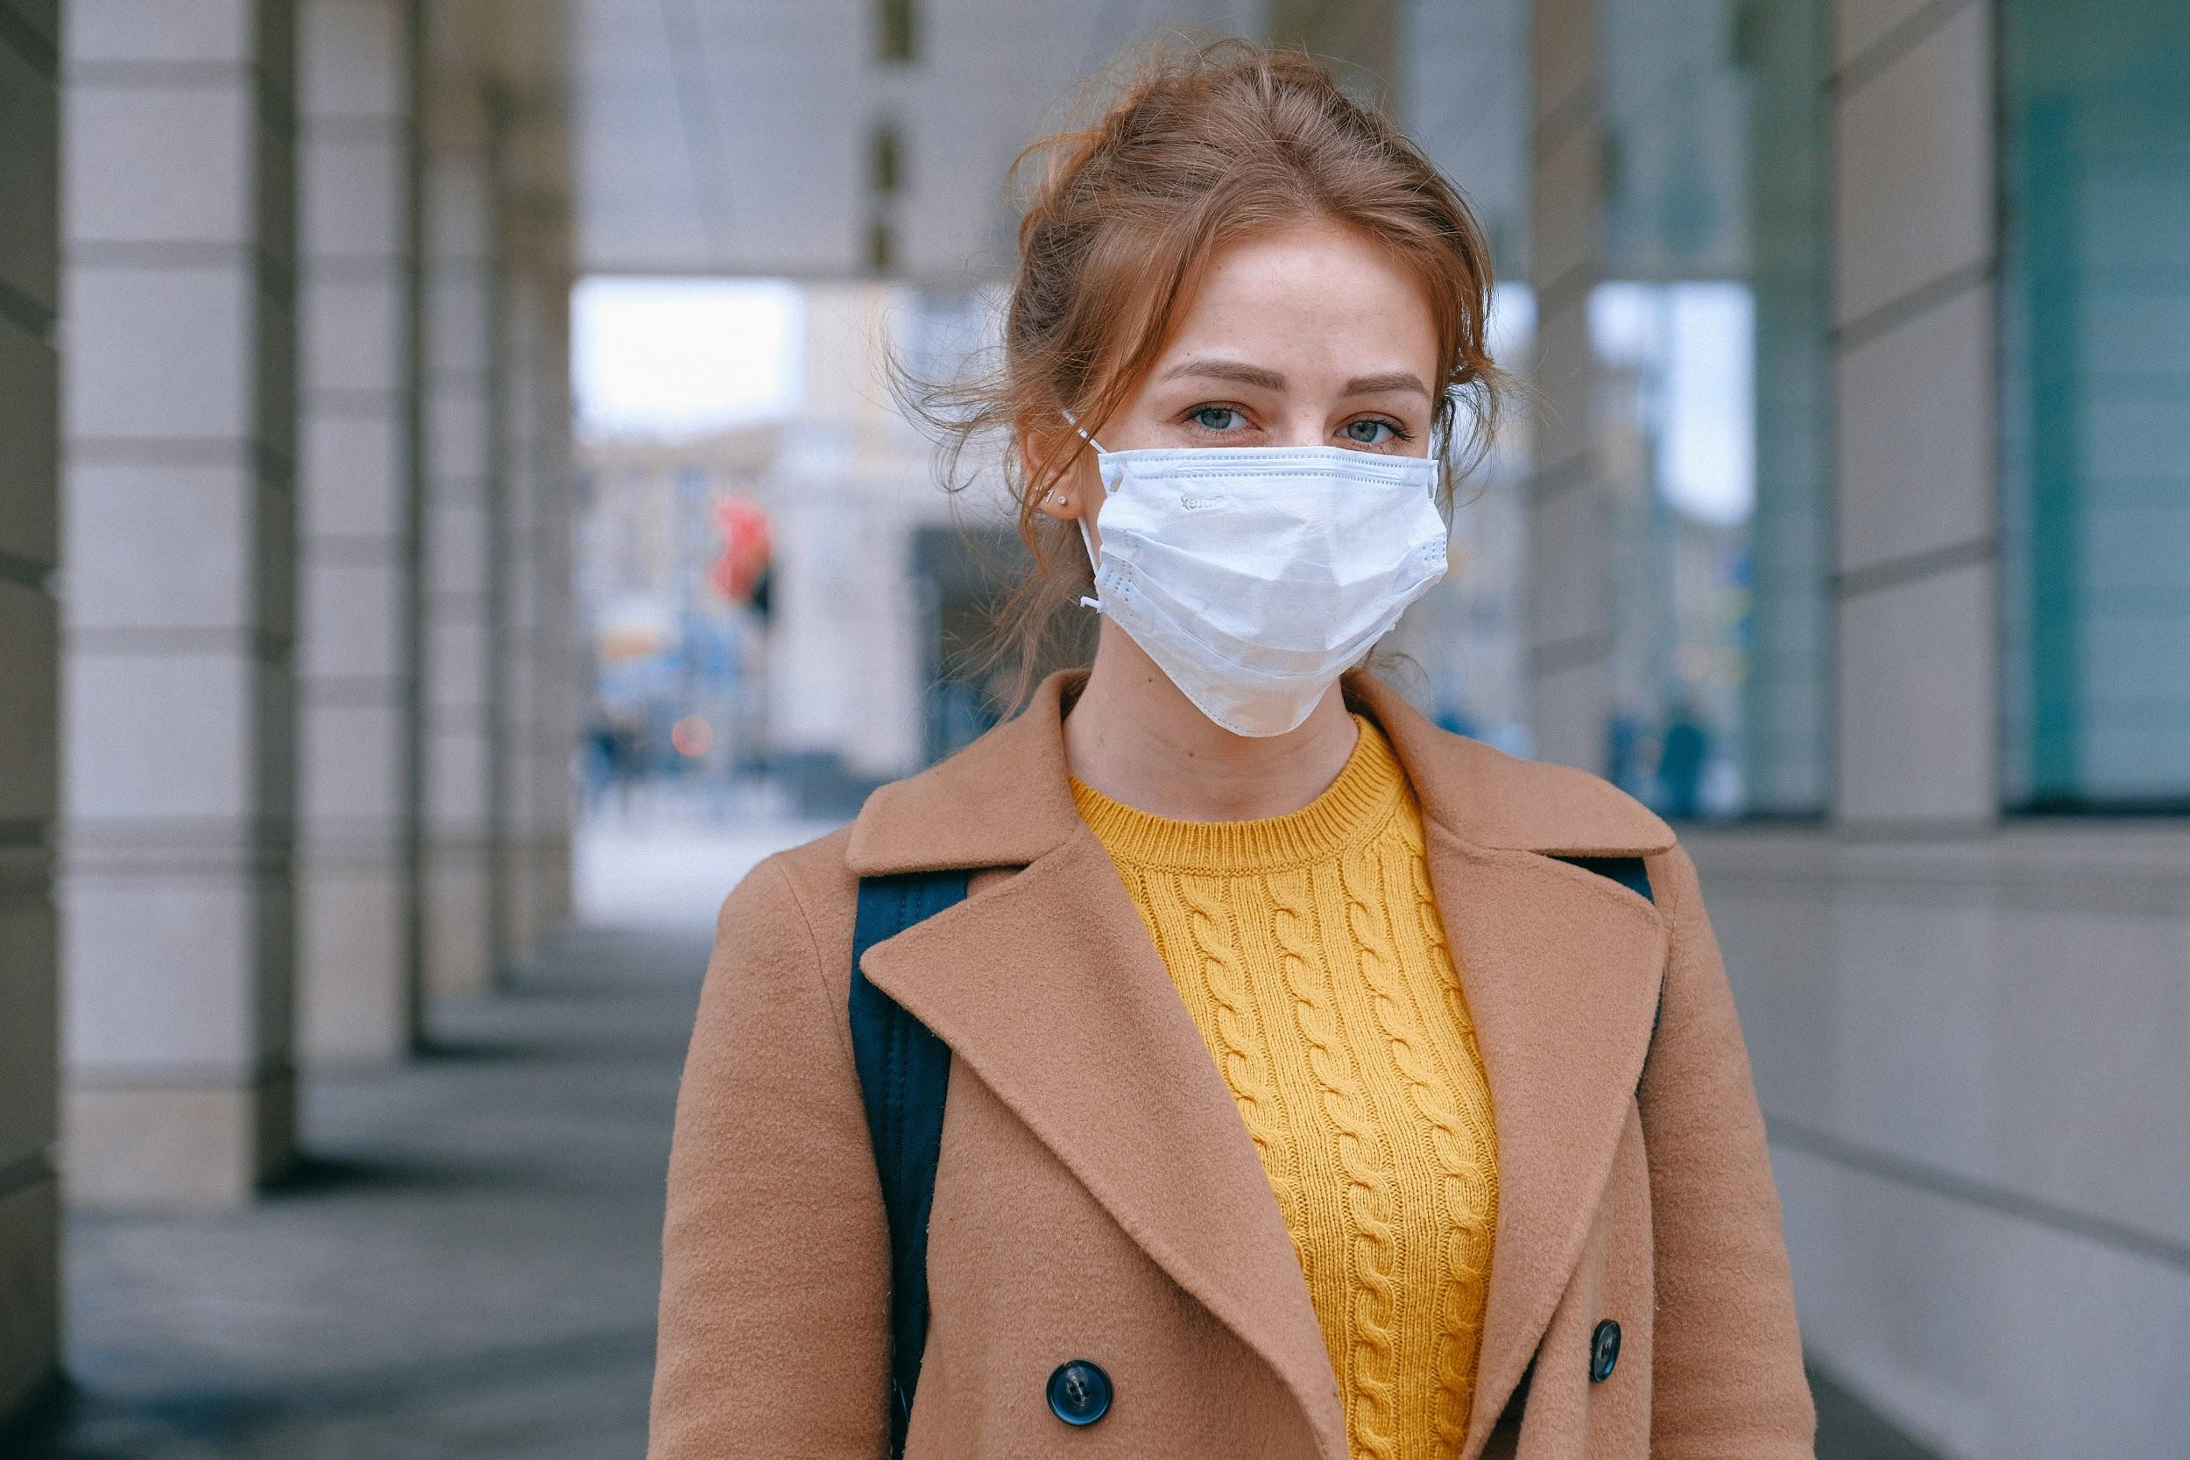
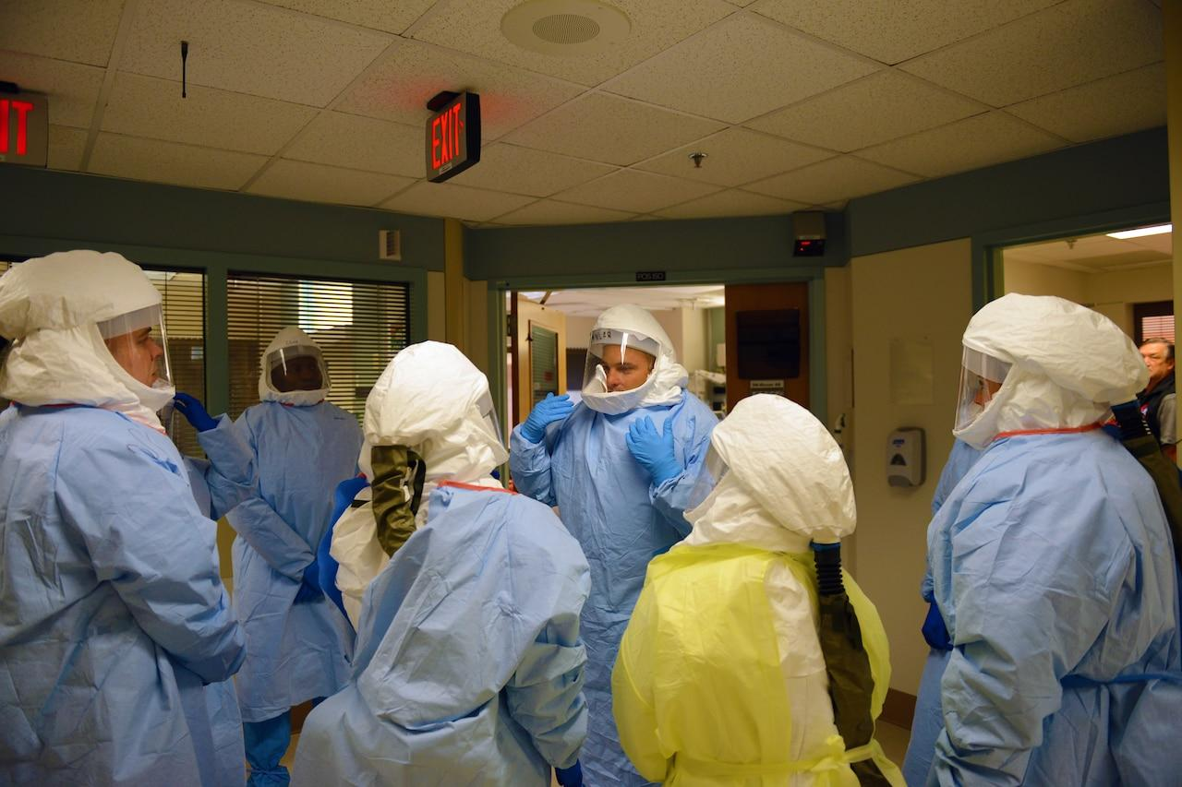
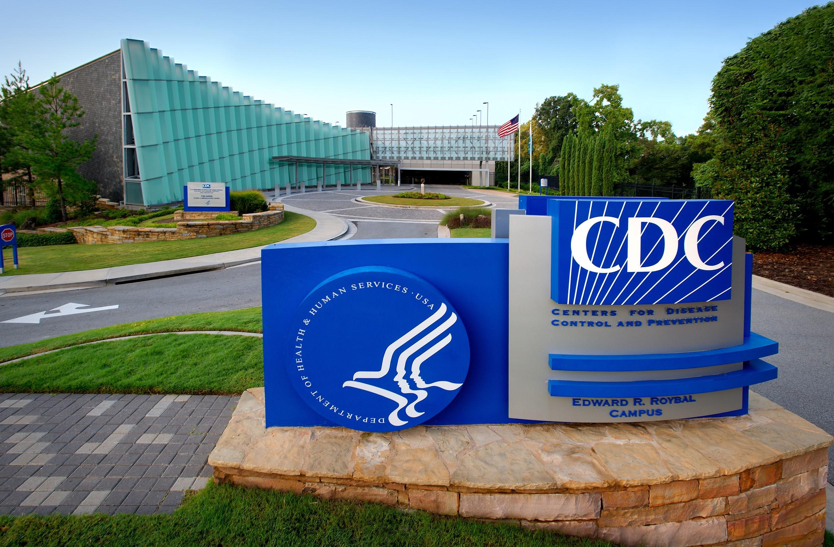
Problem:
Not easy to keep yourself safe
Constant uncertainty if you will catch the virus
To provide fast and accurate disease tracking to people around the world to improve safety and lower transmission.

Slide 8
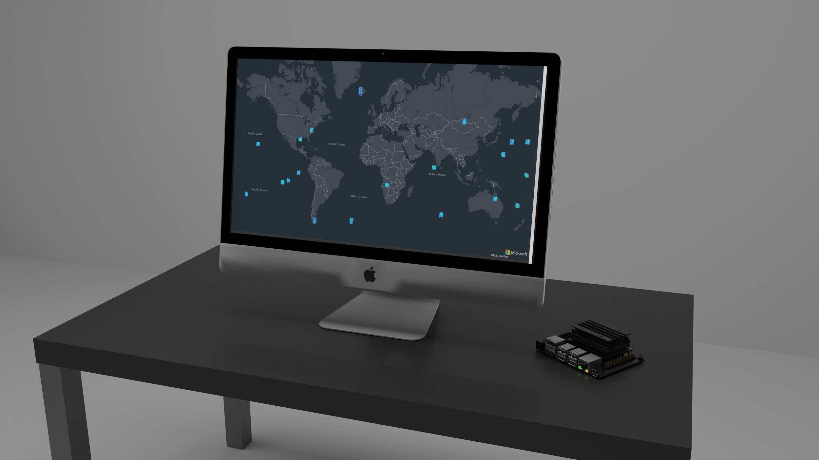
Our Solution:
We use AI to:
Detect the disease in an area
Automatically make maps to convey that information to people

Slide 9

BOARDD
A detailed description of our entire product
3

Slide 10
BOARDD:
How we got it where it is:
Based on the ESP32 and Sipeed Maixduino development boards.
Final Design and Abilities:
Detect respiratory diseases
Estimate concentration of positive cases.

Slide 11
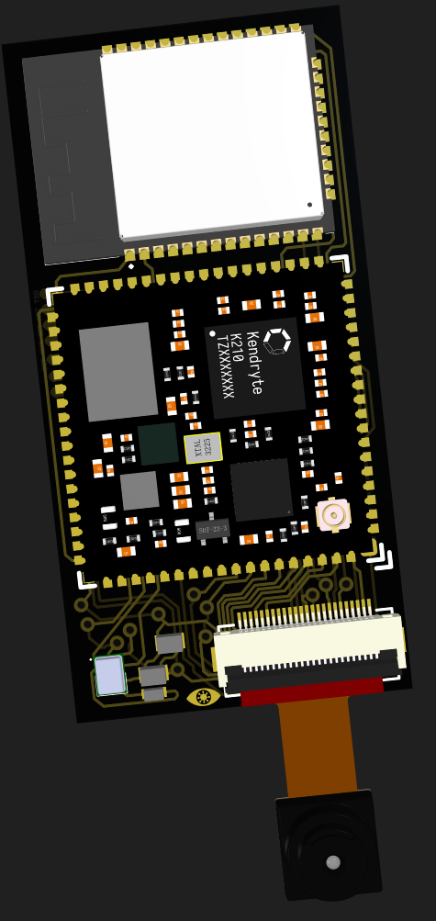
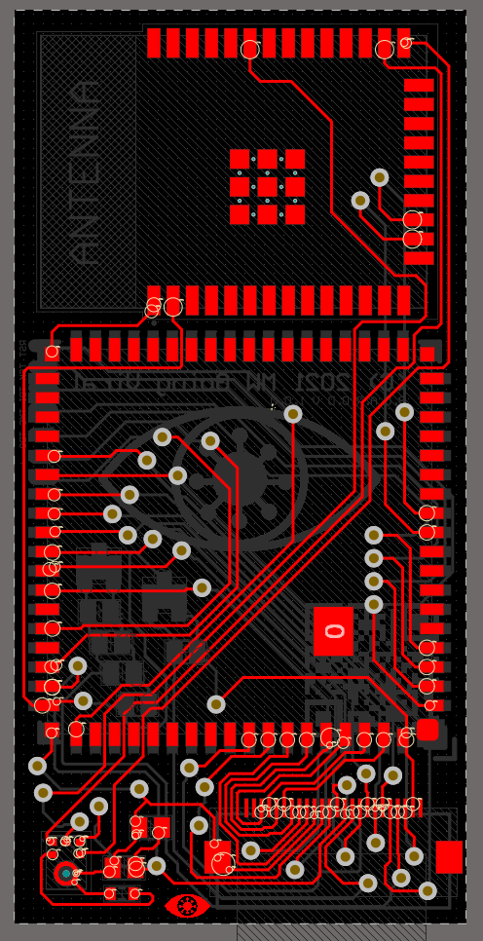
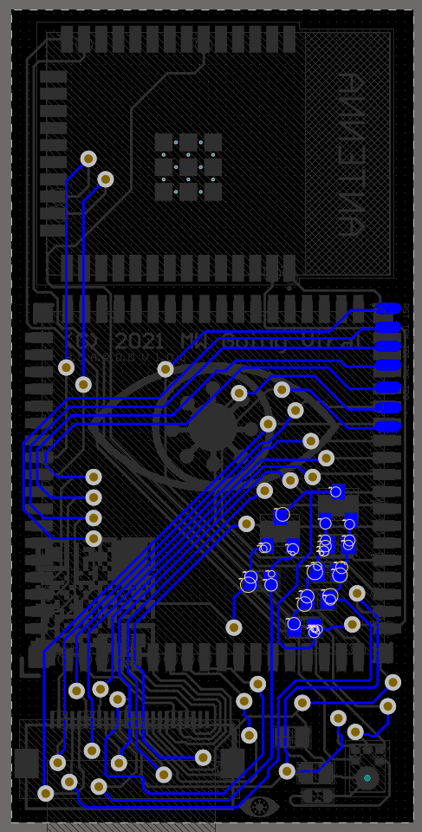
PCB

Slide 12

Server:
How we got it where it is
Originally designed to work as an SQL database
Also hosted on firebase
Final Design and Abilities
Now uses GeoJson
Able to work with thousands of BORADDS

Slide 13

Data Security and Privacy:
Why it’s important:
Data privacy and security is a growing concern in a modern world.
Many people may not like the idea of listening devices in public places
What we have done:
All processing is done on the device
The recordings are not stored or sent to the servers
The devices do not differentiate between people, and can’t be used for facial recognition

Slide 14
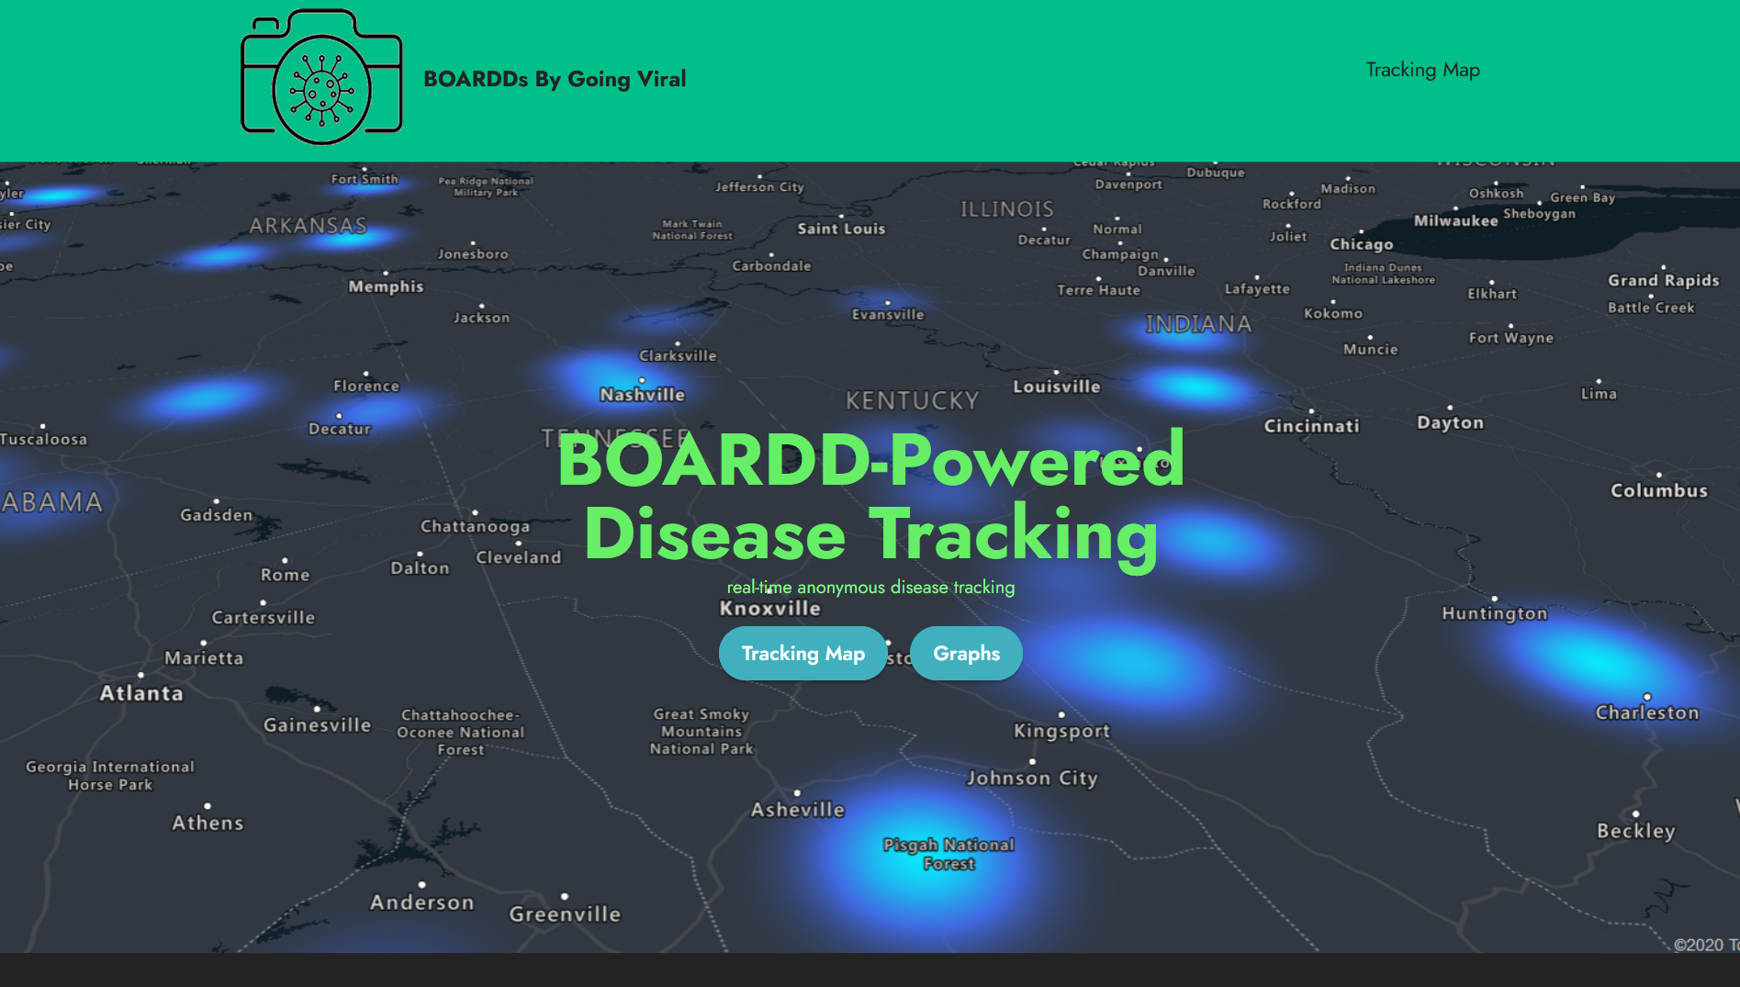
WEBSITE:
How we got it where it is
Front page/ about us page made with Mobirise(to start)
Map uses Azure maps api

Slide 15
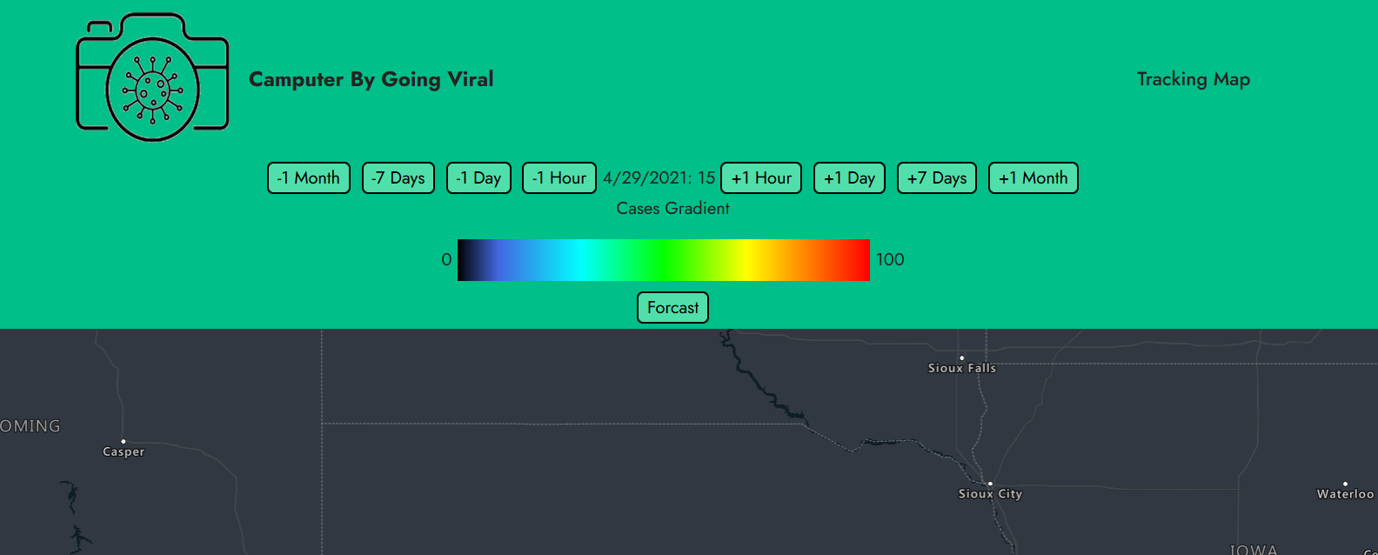
WEBSITE
Final Design and Abilities
Provides a big-picture view
Designed to provide many insights into disease location and prediction

Slide 16
westcs.club/going_viral

Slide 17
BUSINESS PLAN
How we plan on running our business
4

Slide 18
Business Description
Flexible system
Applicable to any infectious respiratory disease
Public benefit
Weaknesses
Difficulty gathering large data sets
Way to render the map with multiple rates of infection
Threats
Medical field advances
Too much surveillance and possibility of “invasion of privacy”
Strengths
High accuracy
Wide diversity of applications
Opportunity
Untouched market

Slide 19
Marketing
Untouched market
Just need one community
Infrastructure
Currently no competition
Low price: $25
Marketed to anyone
Community pitches
Sell to
Governments
Hospitals
Airlines
Grocery Stores
Businesses
Public facilities

Slide 20
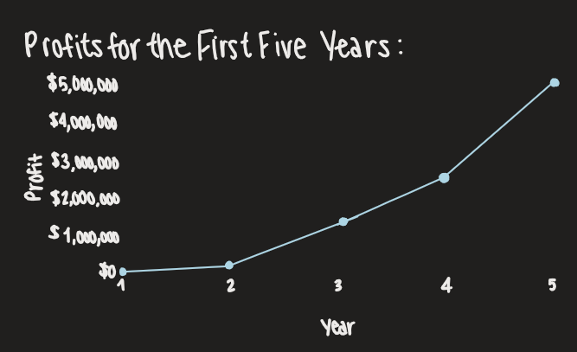
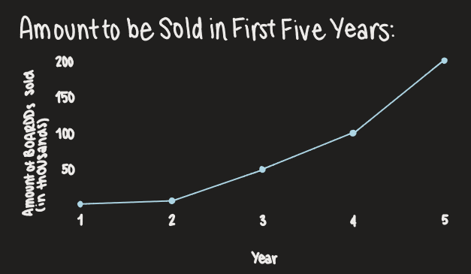
Sales

Slide 21
Financial Plan
Items | Price | Amount
PCB | $0.80 | 1
Sipeed M1W | $8.70 | 1
OV2640 Camera | $1.00 | 1
Mems Microphone | $1.00 | 1
Miscellaneous SMD | $0.50 | 1
Assembly | $3.00
Total | $15.00 | Note: Sold for $25

